Slide 1
SOFTWARES

Slide 2
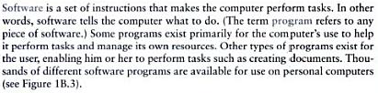
Software - Definition

Slide 3
Types of Software
Software is divided into to major categories:
System Software
Application Software

Slide 4
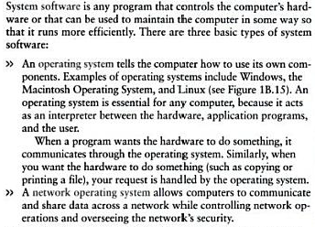
System Software

Slide 5
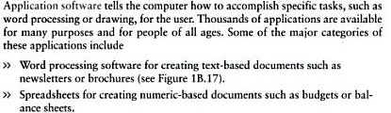
Application Software
More Examples:
Database Management Software
Presentation Programs
Graphic Programs
Multimedia Authoring Applications
Entertainment and Education Software
Web Design Tool ad Web Browsers

Slide 6
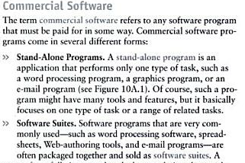
Commercial Software

Slide 7
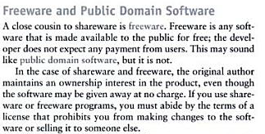
Freeware Software

Slide 8
Open-source Software
Open-source software (OSS) is a type of computer software in which source code is released under a license in which the copyright holder grants users the rights to use, study, change, and distribute the software to anyone and for any purpose.

Slide 9
Application Program - Examples
Word Processing Programs
Spreadsheets Programs
Presentation Programs
Graphic Software (paint programs, photo editing programs, draw programs, computer aided design programs, 3-D modeling and animation program)

Slide 10
Reading Assignment
Topics:
Word Processing Programs (e.g. MS Word)
Spreadsheets Programs (e.g. MS Excel)
Presentation Programs (e.g. MS Power Point)
Graphic Software (photo editing programs, draw programs, computer aided design programs,)

Slide 11
THE END

